Slide 1
Send the presentation to your supervisor no later than one day before the thesis colloquium

Slide 2
Agenda
 |  | Agenda
1 |  | Introduction & Motivation + Research Question
2 |  | Related Work & (Theoretical) Foundations
3 |  | Research Method
4 |  | Results
5 |  | Contributions, Implications, Limitations & Future Research

Slide 5
Note: Citing Sources in Presentations
Whenever you use someone else’s work, whether it is a direct quote, a paraphrase, an image, a chart, or even a fact that is not common knowledge, you need to cite the source
  In-text citations: Add a citation right after the sentence or material
  Images and charts: Include the source directly under the image or chart
  Entire-slide sources: If your whole slide is based on 1-2 sources, you can cite them in a text box at the bottom of the slide
References Slide: At the end of your presentation, include a slide titled References with a full list of sources in APA format (https://apastyle.apa.org/)

Slide 6
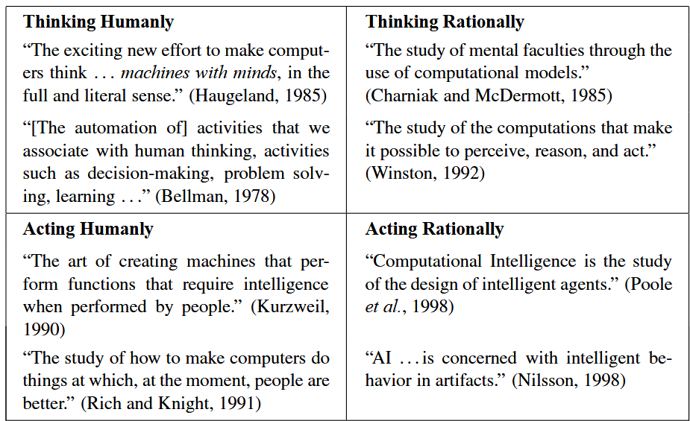
Note: Citing Sources in Presentations – Examples
There are three related, interdependent facets of AI: autonomy, learning, and inscrutability (Berente et al., 2021)
Different definitions of AI (Russell & Norvig, 2010, p. 2)

Slide 8


Thank you for your attention!
Questions?
Foto: Adobe Stock

Slide 9
References
Berente, N., Gu, B., Recker, J., & Santhanam, R. (2021). Managing Artificial Intelligence. MIS Quarterly, 45(3), 1433-1450. https://dx.doi.org/10.25300/MISQ/2021/16274
Russell, S. J., & Norvig, P. (2010). Artificial Intelligence: A Modern Approach (3rd ed.). Prentice Hall.

Slide 10
Appendix

