Slide 1
Kick-Off Event
Master students (MBA, MWI, MIEB)
07.10.2024

Slide 2
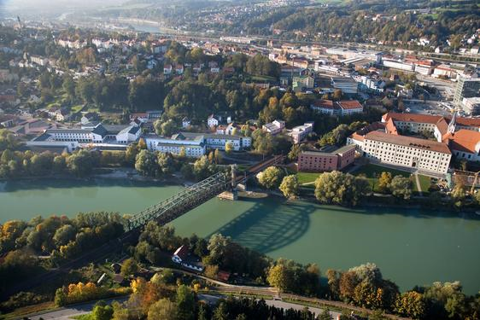
Welcome to the University of Passau

Slide 3
Outline
Who we are
General information about the studies in Passau
FFA for Business and Economics Englisch
Internship / Study abroad
Further notes for your studies
IT-Services
Stud.IP
Campus Portal
Orientationweek („O-Woche“)
Further important (external) dates

Slide 4
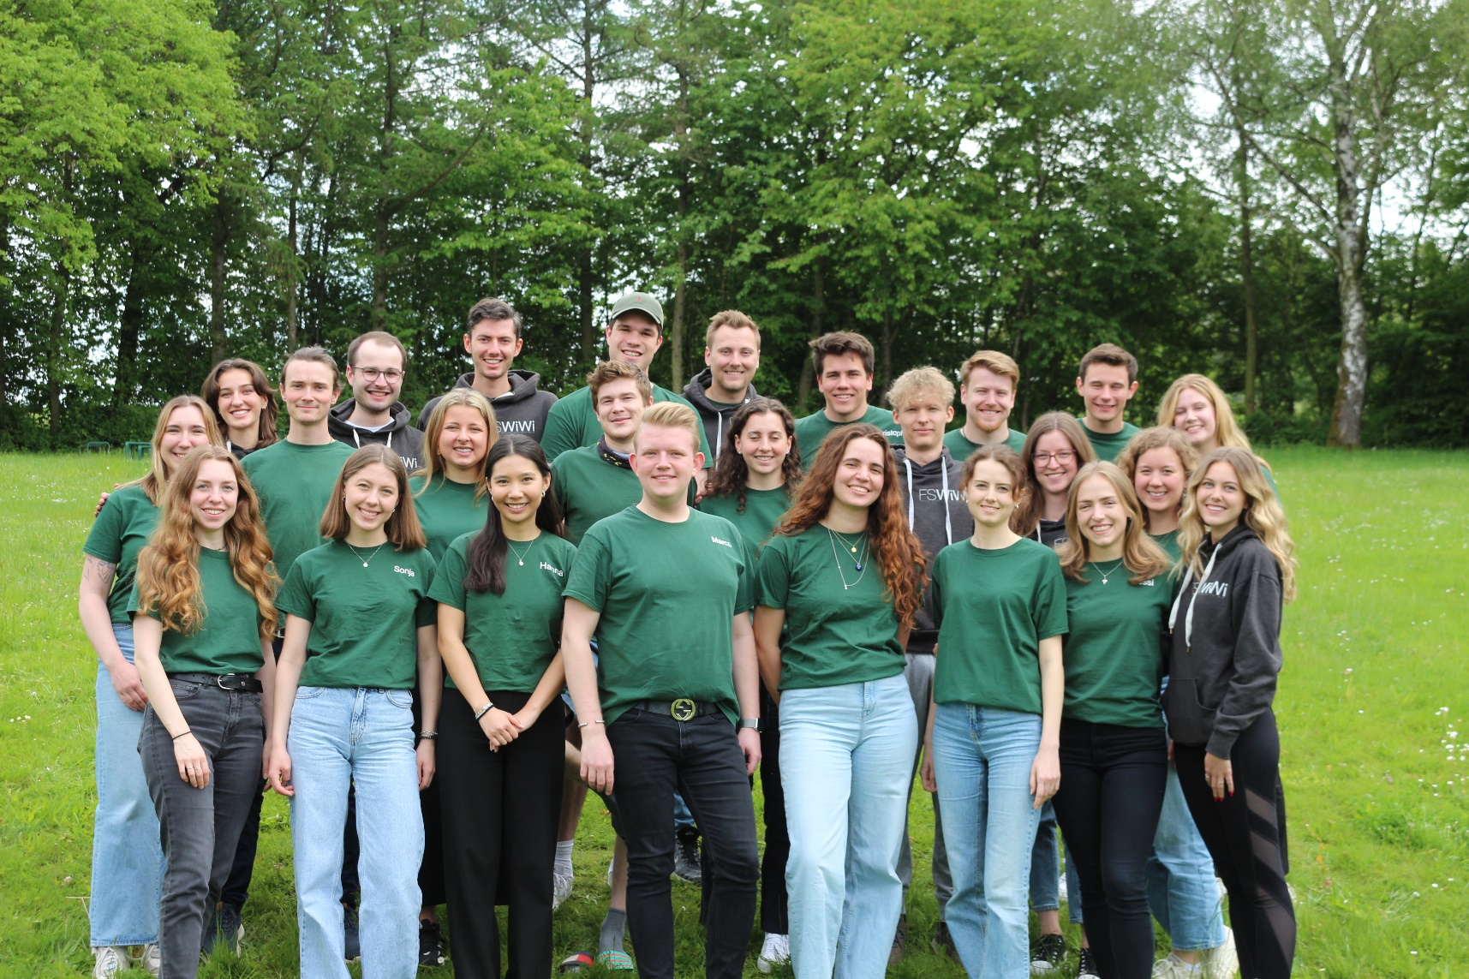
We introduce ourselves

Slide 5
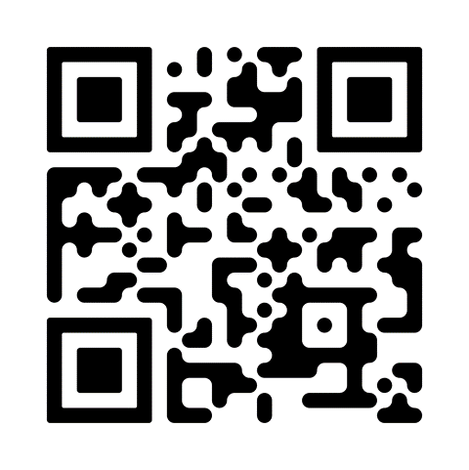
Contact
How can you reach us?
Telefon: (0851) 509 – 2404
E-Mail: fs-wiwi@uni-passau.de
Website: www.uni-passau.de/fachschaft-wiwi
im WIWI: R 025 (Erdgeschoss)
Instagram: @fswiwi_passau
Our opening hours
Mo – Thu between 10 and 15 o‘clock
Fr 10 – 12 o‘clock
Linktr.ee/fswiwi.passau
Notes:
5

Slide 6
What we do
Representation towards faculty & university politics (e.g. Fakultätsrat)
Advice on all aspects of studying (e.g. office, O-Woche)
Fun during your study (e.g. Events)

Slide 7
General information about the studies in Passau
Lecture material: Stud.IP
Campus Card: „Universal card“ (different balances)
Mensa (Canteen & Cafeteria)
Print & copy (extra deposit necessary)
Bus ticket
Library card
Sports center
Registration starts: 07.10. 9 o‘clock
Sports facilities fee: Students 15 EUR / semester
Events of „Zukunft: Karriere und Kompetenzen“ (ZKK)
Coures and seminars for further education
Registration starts: 01.10. 12 Uhr (FCFS – First Come First Serve)

Slide 8
FFA for Business and Economics programme
Language centre (not crediable)
Chinese, English, French, Italian, Polish, Portuguese, Russian, Spanish, Czech
Deadline registration: Depends on the language (some require a placement test) → Homepage
Information event on 07.10.2024 at 18:00 o‘clock (AM HS 10)

Slide 9
Internship / Study abroad
Internship:
optional
always, even during your studies more than advised
Study Abroad:
Integration in your study programme possible
A lot partner universities globally
(currently ≈ 74 partner in 32 countries for WiWi-Master)
Contact: International Office (1. OG VW)
→ A “leave semester” can be applied for both, for an internship and for studying abroad - but no more than two!

Slide 10
Further notes for your studies
First semester:
Teaching important fundamentals
Recommended to prepare and follow up lectures during the semester
It is not advisable to “postpone” courses to subsequent semesters!
→ Retake exams & regular exams in the same period! → Exams are mostly only avaible once a year
Exercises & tutors very important

Slide 11
IT-Services
Stud.IP (Lectures, Timetable, CampusCard)
Ilias (Lectures, Recordings)
Campus Portal (Exam registration, transcript of records, changes in adress etc., certificates)
Workshop (Introduction IT-Services) – more details here
Tuesday, 08.10. 10 - 12 o‘clock (IM HS 13) in German
Friday, 11.10. 10 - 12 o‘clock (IM HS 13) in German
Tuesday, 08.10. 14 – 16 o‘clock (Zoom) in English

Slide 12
Stud.IP
Learning-Management-System
Registration lectures, exercises, tutors
Timetable, schedule
Infosheet, module catalogue
Registration ZKK courses
Registration language courses
Download of teaching material
Registration : ZIM-Kennung (Immatriculation)
e.g.: surname02

Slide 13
Campus Portal
Application
Registration exams
Viewing exam results
Transcript of records
Administration of student data (adress etc.)
Creation of certificates (Kindergeld, Bafög, parking ID etc.)
Registration: ZIM-Kennung
e.g.: surname02

Slide 14
Schedule orientation week

Slide 15
Program
Monday, 07.10.2024
Begrüßung der FS WiWi
Campusführung
Bier & Brezn
Get Together
Tuesday, 08.10.2024
Einführung IT-Dienste
Bib-Führung
Stadtrallye
Speedfriending
Kneipentour
Mo. – Do.: 10 – 12 Uhr Fachschaftsdienst

Slide 16
Program
Wednesday, 11.10.2023
SOS-Stundenplan
Gamehall
Pub Quiz
Thursday, 12.10.2023
SOS-Stundenplan
Bib-Führung
Campusführung
Cook ‘n‘ Run
Mo. – Do.: 10 – 12 Uhr Fachschaftsdienst

Slide 17
Program
Friday, 13.10.2023
Boots-Stadtrundfahrt
Ausflug zum Andorfer
Stay tuned ☺
O-Wochenparty
Saturday, 14.10.2023
Weißwurst-Frühstück
Stay tuned ☺

Slide 18
Important notes about the orientation week
Library tour
Limited capacity
O-Wochenparty in Zauberberg
Entrance fee: 5€
Boat city tour:
Ticket sale (7,- € Children fee) on site→ limited capacity!
Registration required (already open)
Cook ‘n‘ Run
See homepage

Slide 19
Further important (external) dates
This week (more information in the O-Wochen schedule/ on the homepage):
Information event „Fremdsprachen am Sprachenzentrum“ (Mo)
Introduction IT-Services (Di/Fr)
WiWi Library Tour (Di/Do)
"Speed Date mit der Kultur" des Kulturbüros (Do)
Next week:
Official master greeting of the faculty (all masters)
Mo. 14.10.2024 at 14 o‘clock in WiWi HS 6
Master greeting Master Wirtschaftsinformatik/ Master BA Focus Wirtschaftsinformatik
Mo. 14.10.2024 at 18 o‘clock in HK 12 SR 001spo

Slide 20
WE WANT YOU!
Thu. 17.10. at 20 o‘clock in the WiWi (location tba)

Slide 21
Save the date!

Slide 22
HSG WINFO PASSAU
DAS BIETEN WIR EUCH:
Vernetzung mit anderen Studierenden
Hilfe bei der Studienorganisation
Exkursionen, Kaminvorträge und Infos zu Praktika
Events (Bierpongturnier, Weihnachtsmarkt)
Folgt uns auf Instagram, Facebook und LinkedIn, um nichts zu verpassen!
HSG Winfo Passau
hsg-winfo@uni-passau.de
Schaut gerne bei uns vorbei!
Immer mittwochs 20:00 Uhr, WIWI SR 026
https://www.winfo.uni-passau.de/hochschulgruppe-winfo

Slide 24
That’s all folks…
Enjoy the orientation week and a good start in Passau!
Questions?

