Slide 1

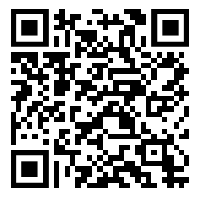
International Economics after your Bachelor?
M.Sc. International Economics and Business
An English-taught Master’s degree in world trade, financial markets, institutions and development.
For students who wish to understand economic relationships in an international context, examine them empirically and analyse them from a political perspective.
QR-Code
hier einfügen
Global Economy
Trade & Finance
Institutions & Development
Small groups · research-oriented · international cohorts · 100% Englisch
Degree programme · Application · Modules

Slide 2


Why the MIEB in Passau?
Top Position:
International Economics
Research & Methods
Personal Study Environment
World trade, financial markets, governance, institutions and development.
Econometrics, data analysis, experiments and field studies.
Small seminar groups, close contact with lecturers and international students.
QR-Code
hier einfügen
Flexible options: Business · Languages · Law · Politics · Cultural Studies
Degree programme · Application · Modules

Slide 3
Occupational field
Economics is open to various fields and positions
Examples are positions in banking, insurance, medium-sized enterprises with an international orientation, consulting, public and international organizations
Doctorate in the field of economics, business administration, political science
Economists have one of the lowest unemployment rates in Germany.

Slide 4
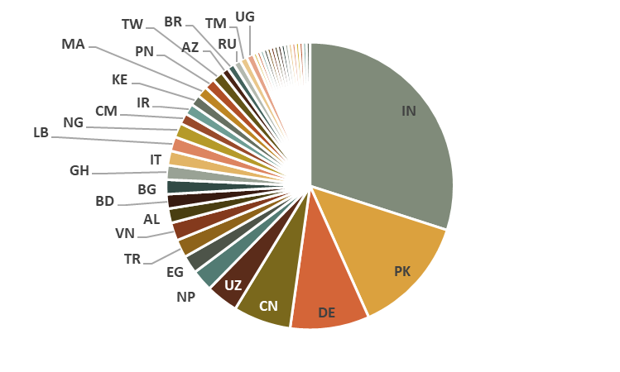
Master of Science in
International Economics and Business
373 applications in 2025
106 passed stage 1
Checking the bachelor degree or transcript of records grades and focus on economics and methods
41 passed stage 2
Interview via Zoom, consisting of single choice test and presentation

Slide 5




A: Core Courses 25-30 ECTS
B: Adv. Methods $≥$ 10 ECTS
C: Global Econ. $≥$ 10 ECTS
D: Gov & Dev. $≥$ 10 ECTS
E: Business $≤$ 20 ECTS
F: Lan-guage
G: Interdisc.
Advanced Macroeconomics
Advanced Microeconomics
Natural and Field Experiments
Fundamentals of International Trade
Econometric Methods
Micro Development Economics
Foundations of Econometrics
Topics in Applied Econometrics
Behavioral Game Theory
Experimental Economics
Seminar Applied Statistics
Advanced Data Analytics
Fundamentals of Business Analytics
Computational Statistics – Regression and Learning in R
Lectures in Advanced Methods 1 + 2
Advanced International Trade
The Empirics of International Trade
Recent Topics in International Trade
International Monetary Economics
Seminar Advanced Macroeconomics
Advanced Corporate Finance 1 + 2
Seminar Advanced Corp. Finance
Lectures in Advanced International Economics 1 + 2
Evaluation of Development Policies
Economics of Corruption
Population Economics
Behavioral Public Economics
Seminar in Public Economics
Economics of Education
Economics of Crime
Health, Development and Public Policy
Growth, Inequality and Poverty
Seminar in Development Economics
Lectures in Governance, Institutions and Development 1 + 2
Sustainable Leadership
Organizational and Competitive Strategy
Strategic Innovation and Change
International Accounting
Reporting of Digital Business Models
Advanced International Accounting
Telecommunica-tions Management
Electronic Markets
Organizational Behavior
Financial Statement Analysis
International Cooperation and Networks
Lectures in Advanced Business Administration
English
French
Spanish
German
Further languages
Interdisci-plinary speciali-zation 1
Interdisci-plinary speciali-zation 2
Interdisci-plinary seminar

Slide 6
Sample curriculum “Global Economics”
1
WiSe
Advanced Macroeconomics
Advanced Microeconomics
Natural and Field Experiments
Fundamentals of International Trade
Behavioral Game Theory
Advanced Data Analytics
2
SoSe
Computational Statistics – Regression and Learning in R
Advanced International Trade
The Empirics of International Trade
International Monetary Economics
Seminar Advanced Macroeconomics
Advanced Corporate Finance 1
3
WiSe
Econometric Methods
Foundations of Econometrics
Seminar Advanced Corp. Finance
Advanced Corporate Finance 2
Behavioral Public Economics
Lectures in Advanced International Economics 2
4
SoSe
Recent Topics in International Trade
Population Economics
Master Thesis

Slide 7
a
Sample curriculum “Governance & Development”
1
Micro Development Economics
Advanced Microeconomics
Natural and Field Experiments
Econometric Methods
Foundations of Econometrics
Growth, Inequality and Poverty
WiSe
2
Seminar in Development Economics
Evaluation of Development Policies
Economics of Corruption
Population Economics
Health, Development and Public Policy
SoSe
Computational Statistics – Regression and Learning in R
3
WiSe
Fundamentals of International Trade
Advanced Data Analytics
Behavioral Game Theory
Lectures in Advanced International Economics 1
Behavioral Public Economics
Lecture in Governance, Institutions and Development 2
4
Seminar in Public Economics
International Monetary Economics
Master Thesis
SoSe

Slide 8
Late arrival
You must enrol for the winter semester.
If visa delays prevent your timely arrival, you may join later—even during the following summer semester.
However, the curriculum is designed for a start in the winter semester.
Late arrival is formally possible but may substantially impede your academic progress.
Working as a student
Working as a student• International students are generally allowed to work alongside their studies (up to 20 hours per week during the lecture period).
Student jobs are available at the university and with local companies, both during the semester and during semester breaks.
Such jobs can contribute to your living expenses, but should not be regarded as a guaranteed source of funding.

Slide 9
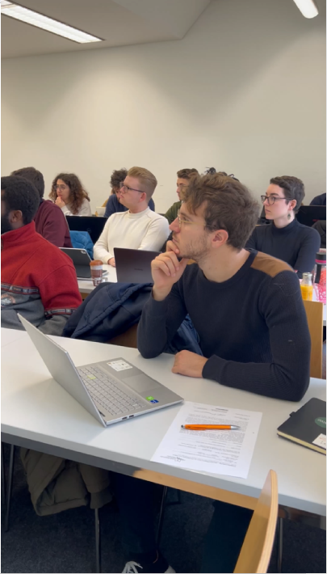
Looking forward to seeing you in October!

