Slide 1
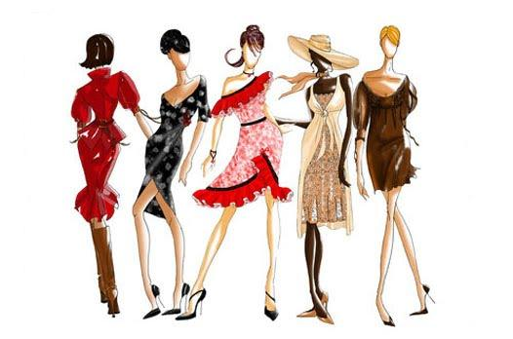
Invited lecture
“Strategy in the Fashion Industry”
Henning Gerbaulet
CEO Eterna Mode GmbH
14.01.2016
10:15h-11:45h
HS 8 (WIWI)
Notes:
http://www.greenandpeter.co.uk/sites/www.greenandpeter.co.uk/files/images/23504bc.jpg

